Slide 1
Project Presentation 2
18102082 Su Kyoung Oh
18102092 Won Ryeol Jeong
16102284 Sung Ho Lee

Slide 2
Contents
Crawling Result
TextRank Algorithm
Data Visualization
Feedback & Plan

Slide 3
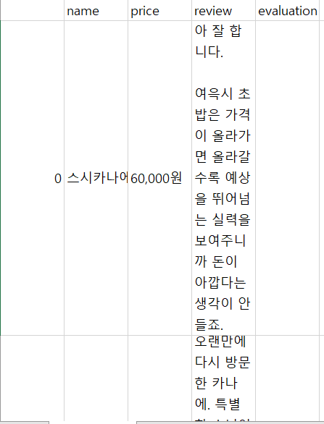
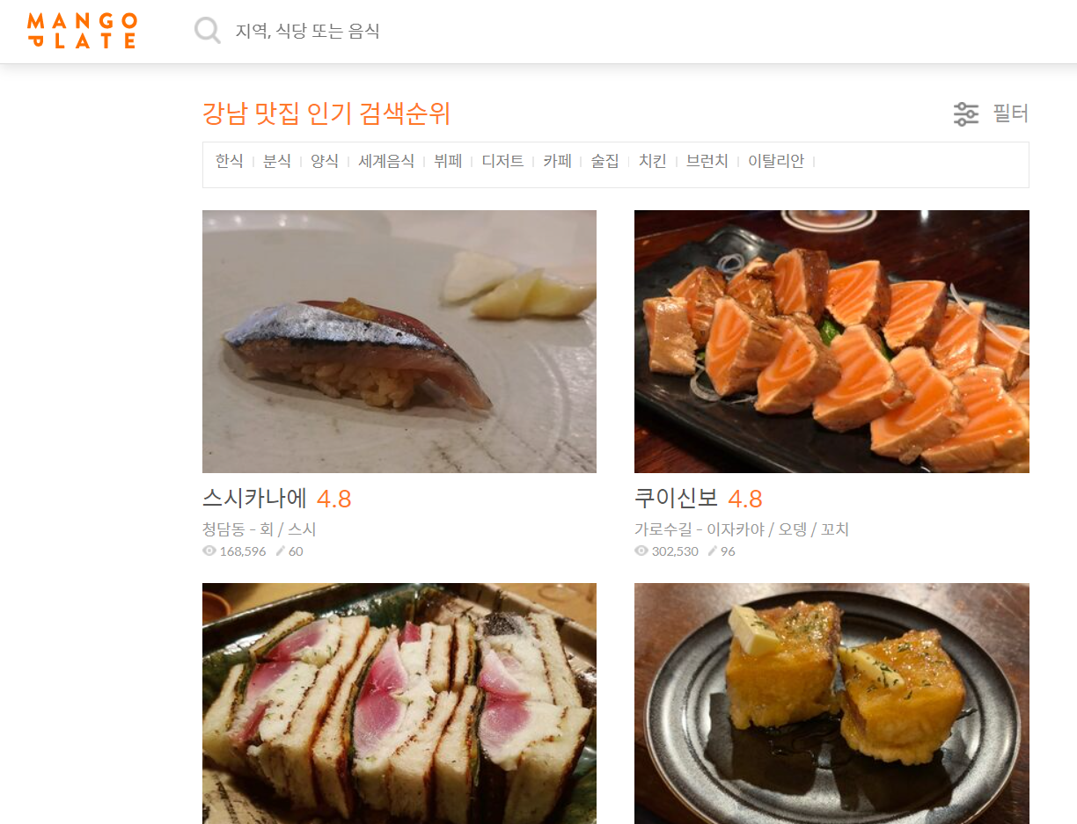
Crawling Result
Crawling
<GangnamGu Restaurant Review>

Slide 4
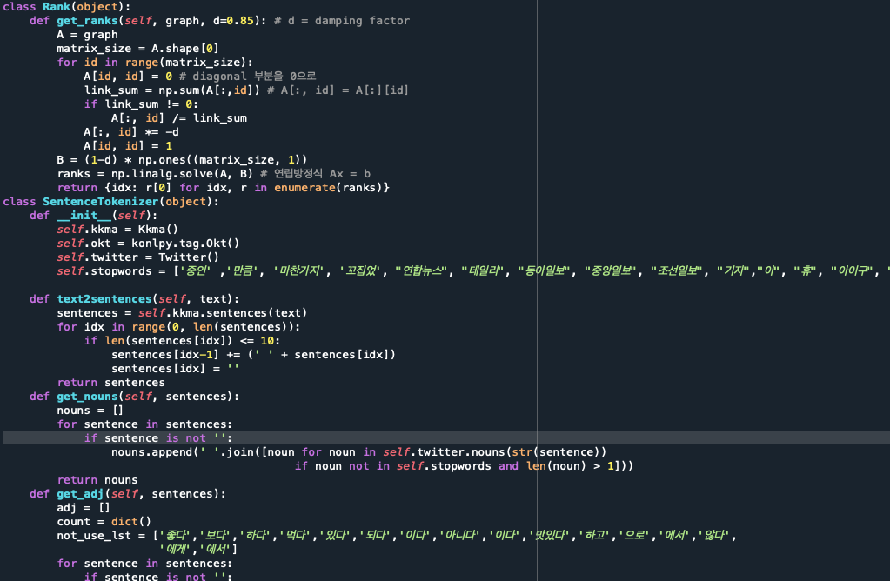
TextRank Algorithm
Text-rank algorithm was introduced for preprocessing of sentimental analysis.
We tried to tokenize the reviews and classify the parts, and then applied the method of weighting the words such as nouns, adjectives, verbs, etc., which are expected to have a significant impact on the ratings according to their relative importance.

Slide 5
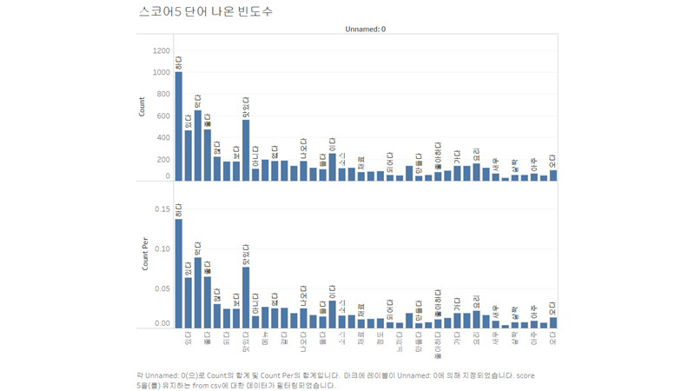
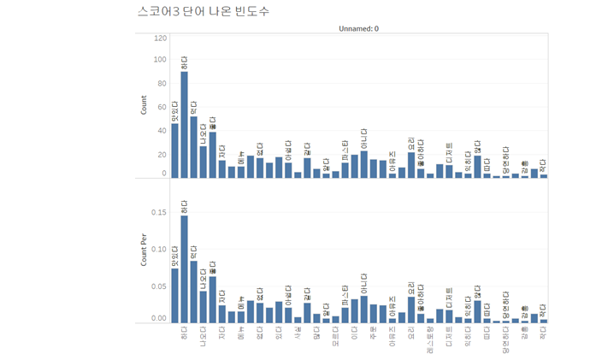
Data Visualization
(※The graph`s order is descending from the left to the [‘rank’])
Frequency of word appearance of text rank algorithm results for 'score 5'
Frequency of word appearance of text rank algorithm results for 'score 3'

Slide 6
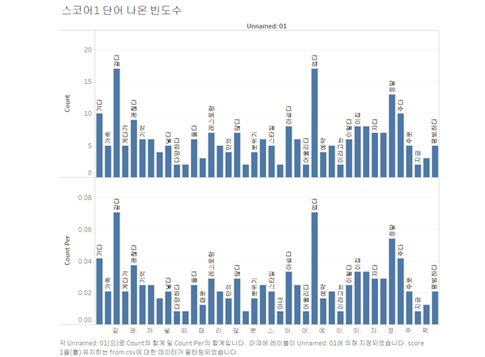
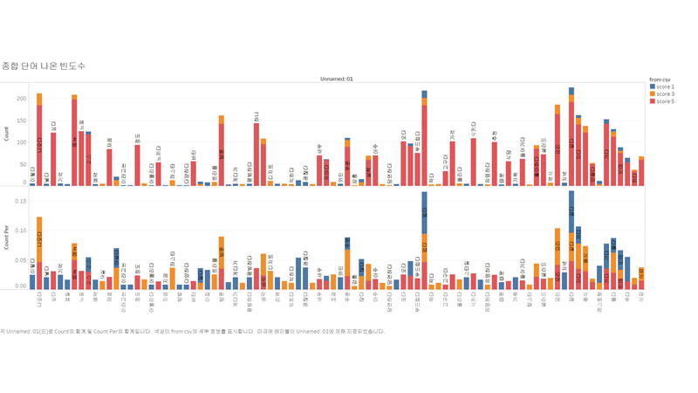
Data Visualization
(※The graph`s order is descending from the left to the [‘rank’])
Frequency of word appearance of text rank algorithm results for 'score 1'
Frequency of word appearance of text rank algorithm results for whole score class

Slide 7
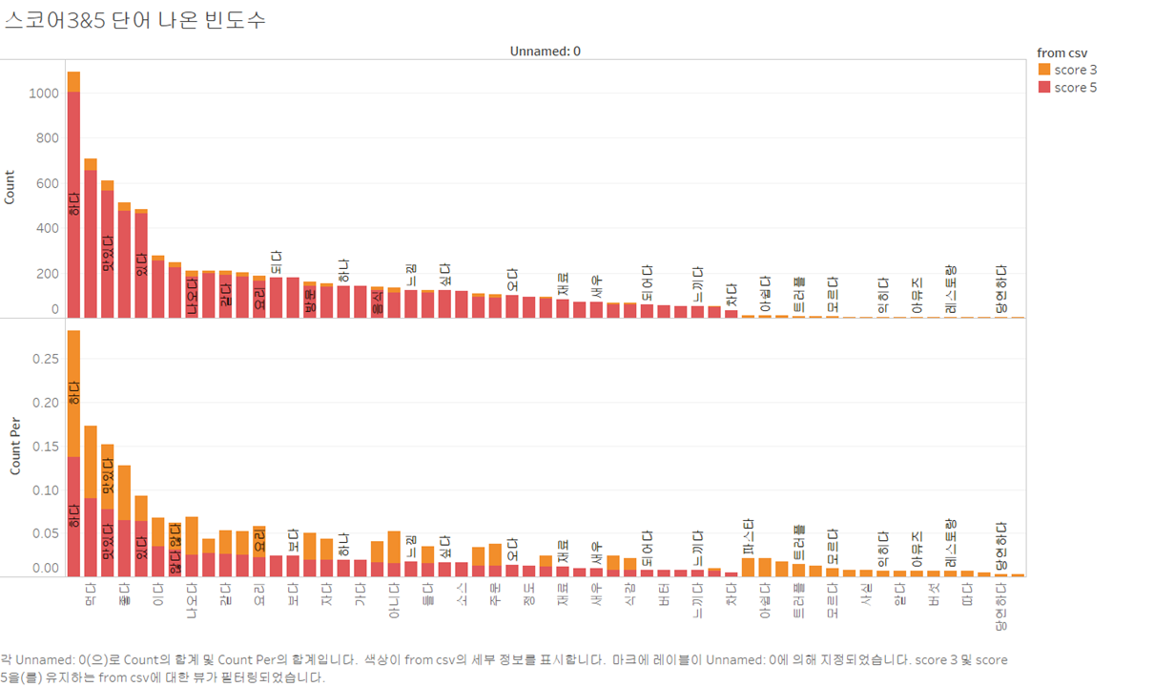
Data Visualization
From earlier visualizations, we can clearly see a big difference between negative reviews (score 1) and others.
Therefore, we visualized scores 3 and 5 together as they are similar

Slide 8
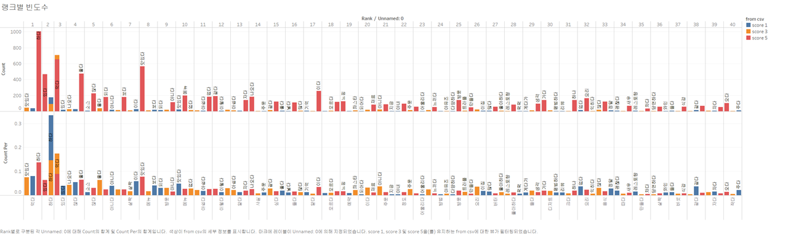
Data Visualization
Frequency of words between each score class by ‘rank’

Slide 9

Data Visualization
As a result of applying the text ranking algorithm without any preprocessing, words with significant insights tend to be buried because of meaningless data such as '하다', 좋다' and '이다'.
So we'll take these words out and reapply the text ranking algorithm again!
<Examples of Unnecessary words>

Slide 10
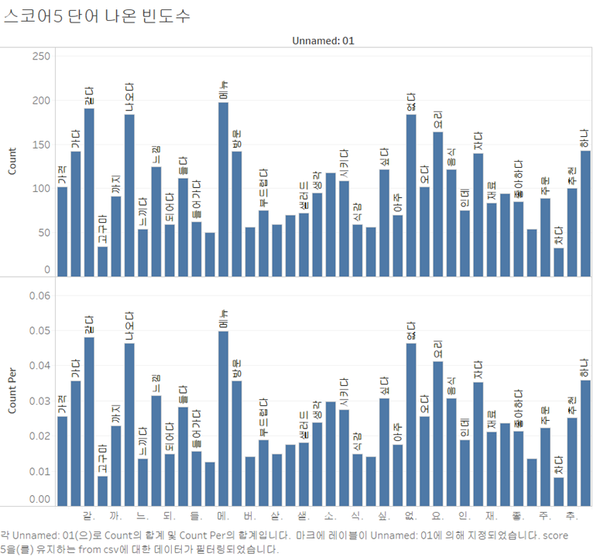
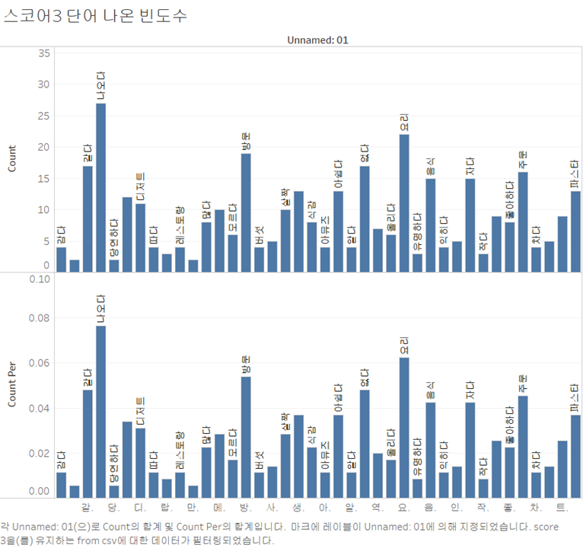
Data Visualization
(※The graph`s order is descending from the left to the [‘rank’])
Frequency of word appearance of text rank algorithm results for 'score 5'
Frequency of word appearance of text rank algorithm results for 'score 3'

Slide 11
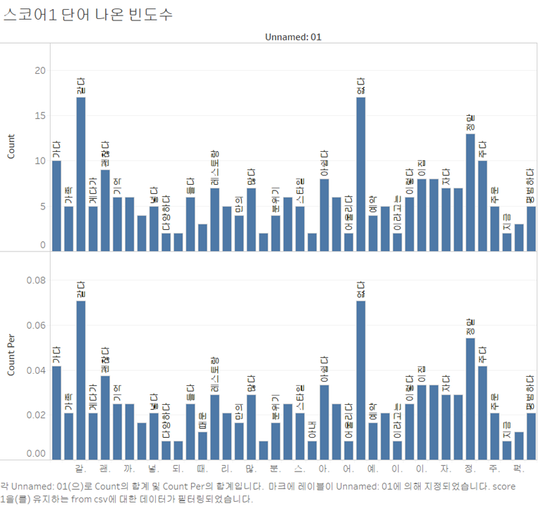
Data Visualization
Frequency of word appearance of text rank algorithm results for 'score 1'
Frequency of word appearance of text rank algorithm results for whole score class

Slide 12
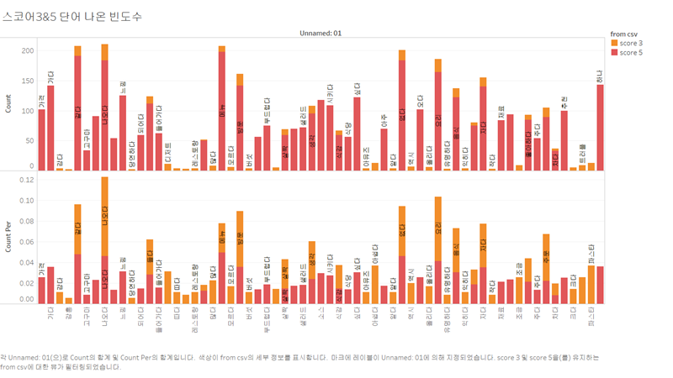
Data Visualization
From earlier visualizations, we can compare each class of frequency of words.
However,after preprocessing, there is difference between ‘score 3’ and‘score 5’, unlike the previous visualization.

Slide 13
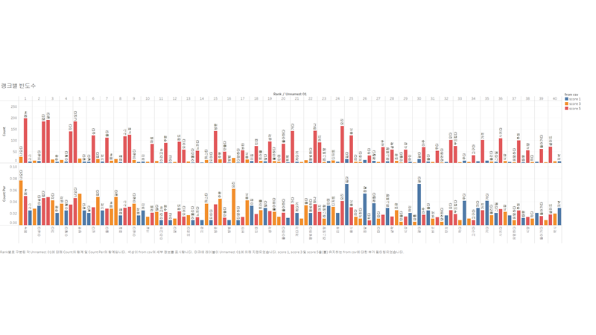
Data Visualization
Frequency of words between each score class by ‘rank’

Slide 14
Feedback & Plan
EDA on Korean reviews for sentiment analysis.
As a result of data collection, there is a difference scale of data between the classes, so we will proceed with under-sampling or over-sampling to resolve this.
From now on, we will try the same process for English reviews.
When this is done, we will make several columns like the dummy data.
Based on this preprocessing, the model will be built to find new insights by obtaining the necessary cut-off and coefficient to go to the corresponding review rate class.

Slide 15


